Slide 1
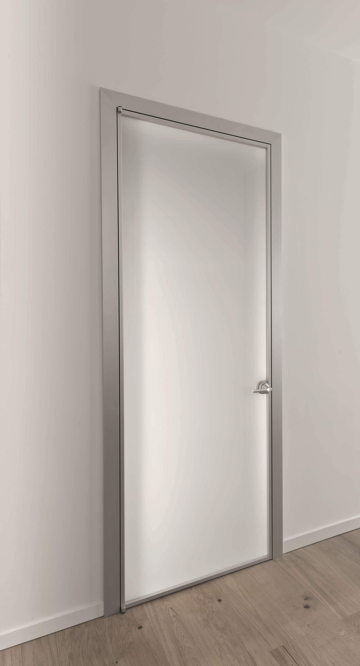

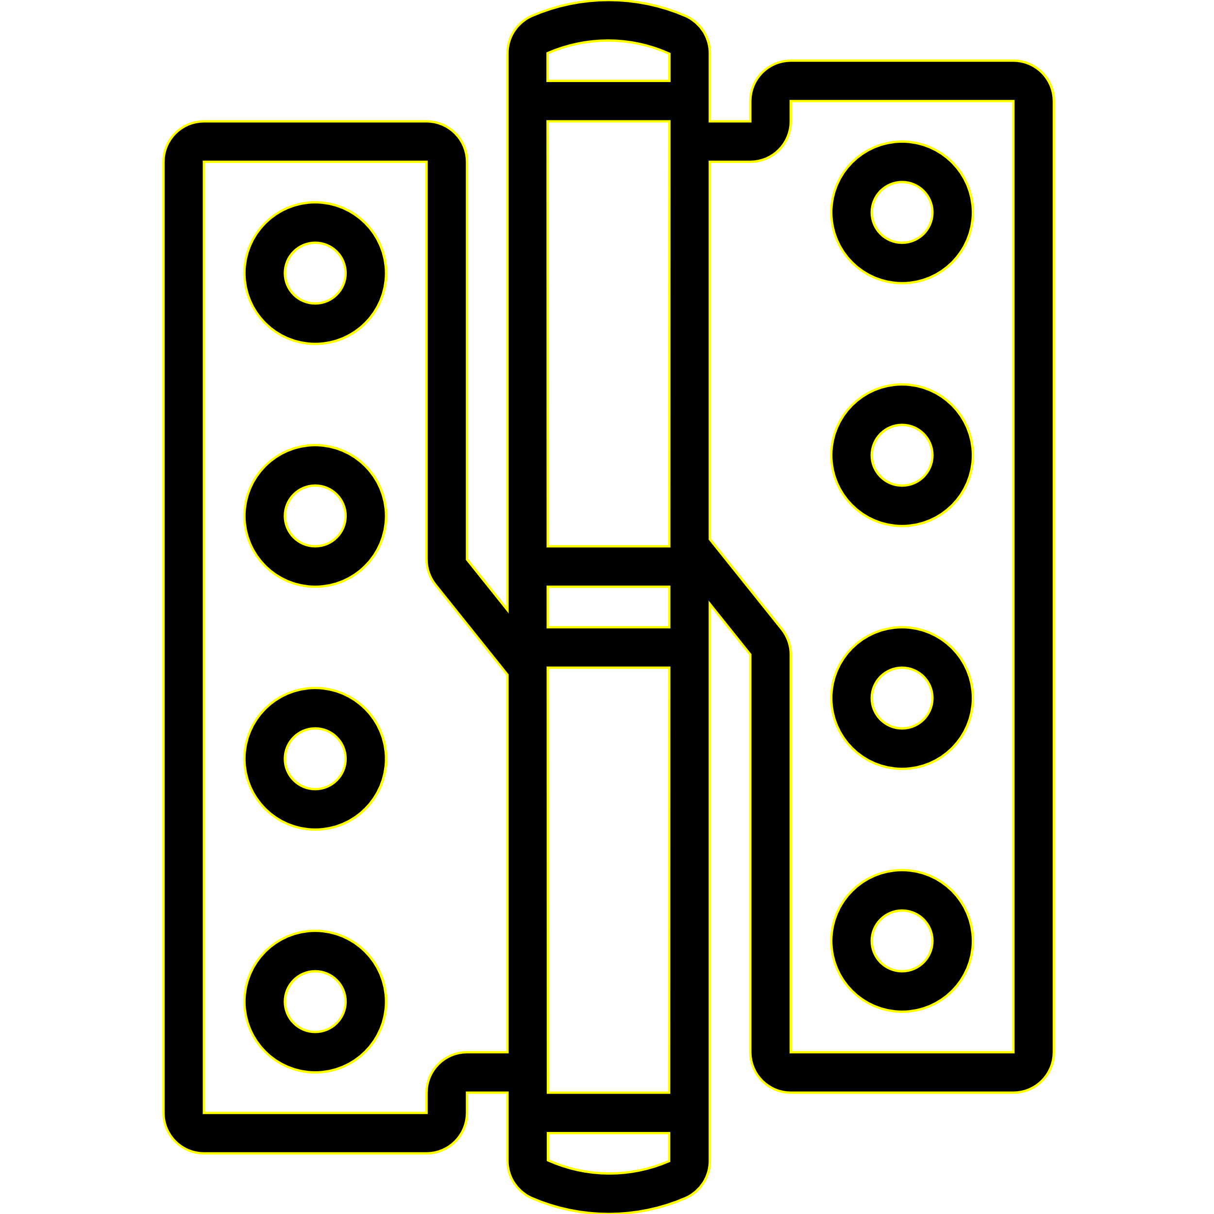
Durable and Handy External Plastic Pivot Hinge with DfAM
20151229 Chanyoung Park

Slide 2

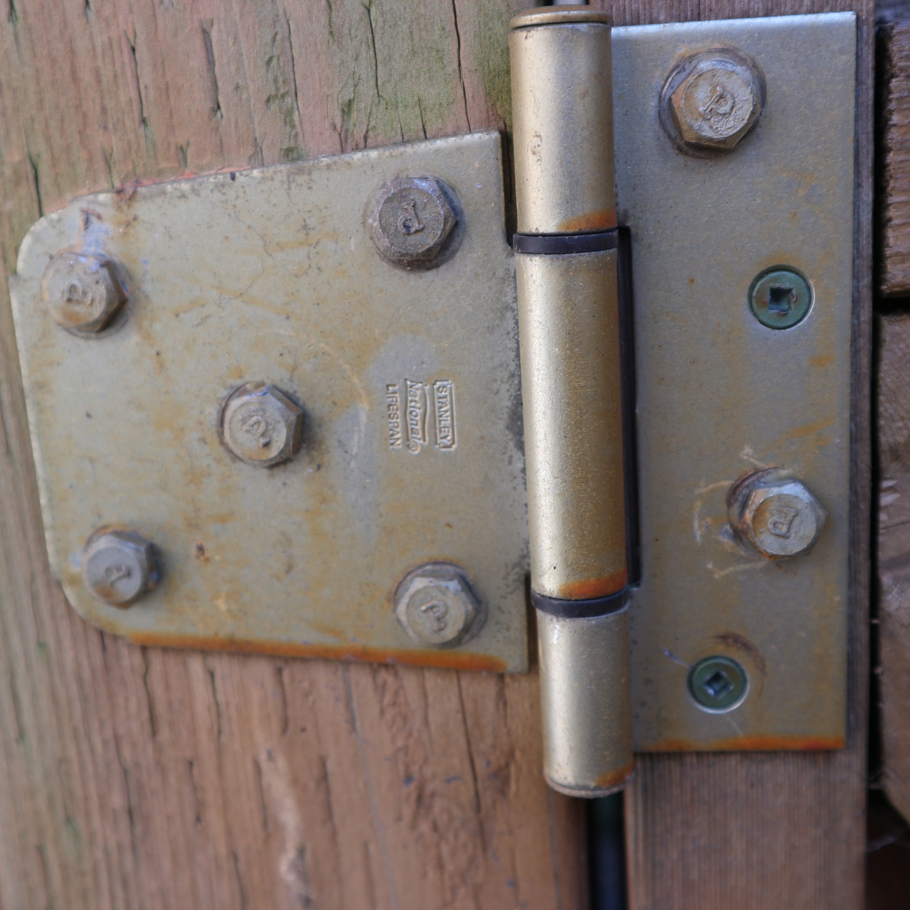
Problem Description
Our target is door in our house bathroom. Usually, door hinges are made of steel material, but it is exposed outside. If you look at the bathroom in your house, you can see that the hinge is rusted.
Also, these are very difficult to install because they need to be installed between a door and a frame.
Water
other matter
Durable and Handy Plastic Pivot Hinge !!!!!

Slide 3

Goal and Solution
First
it must be resistant to
deformation by foreign materials.
Second
it should be a design that is easy to install when replacing hinge.
Third
it must be simple and aesthetically free in design.
Minimal Structure
Plastic Hinge
Pivot Hinge
Our Solution
Durable and Handy Plastic Pivot Hinge

Slide 4
Engineering Limitation
Minimal Structure
Plastic Hinge
Pivot Hinge
Problems In Real World
1. Plastic has weaker tensile strength than metal
2. Easy to install and design
Design Elements and Analysis Points
Optimized Design by using FEM
Hinge with External Pivot

Slide 5
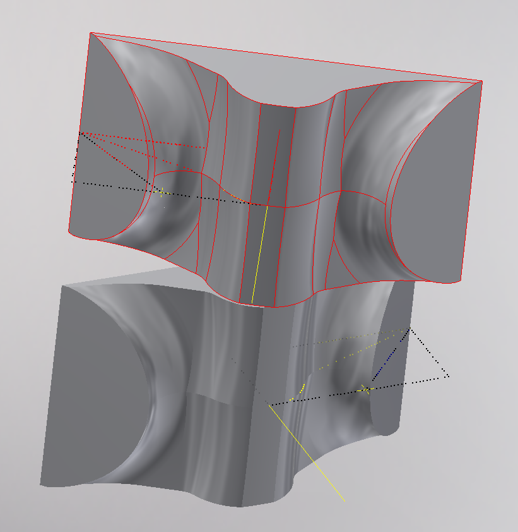
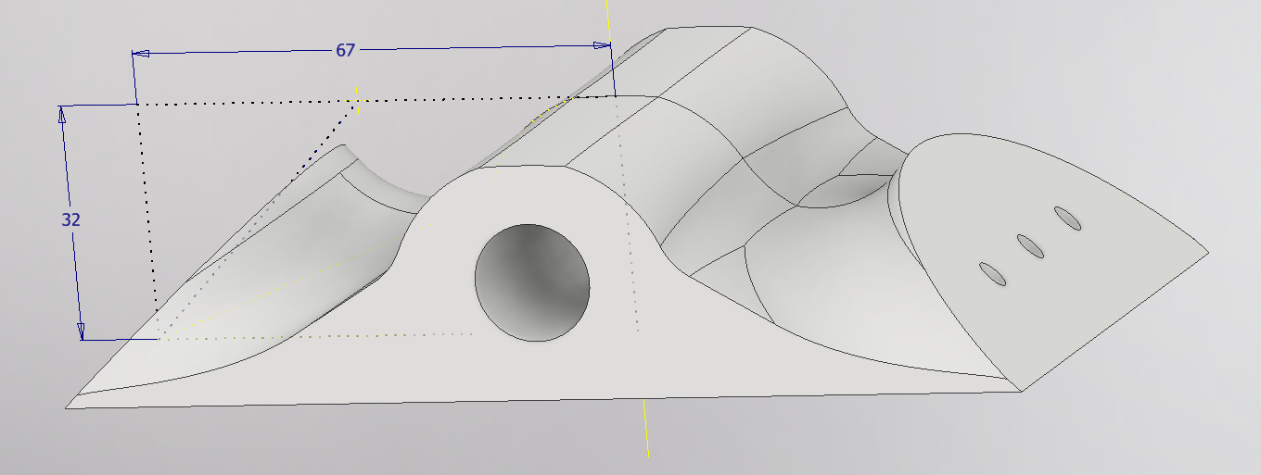
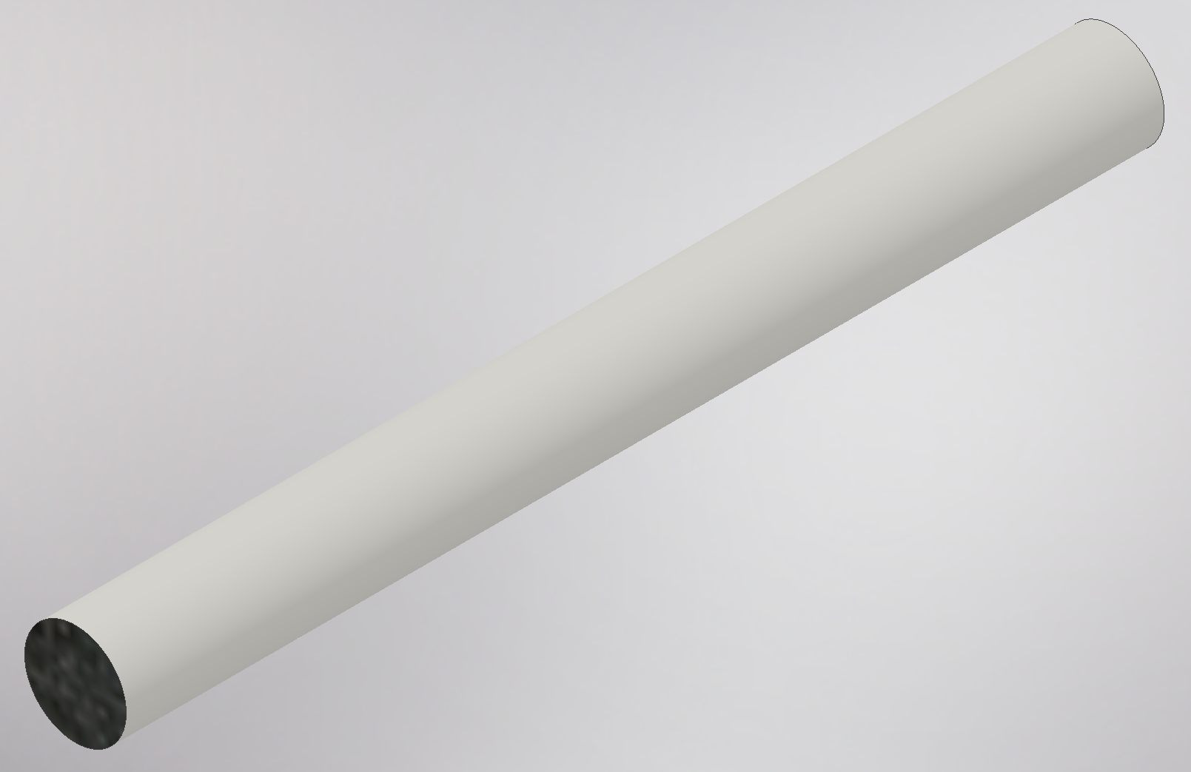

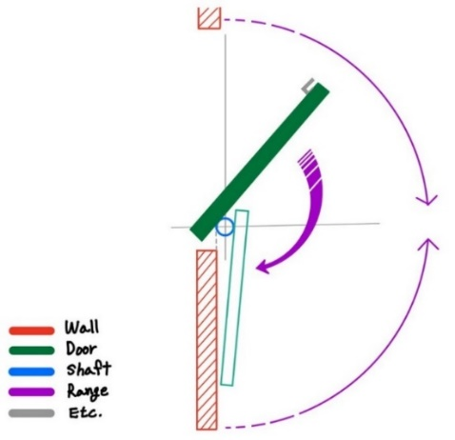
Our Product
- Meged View -
Parts
Hinge X 2
Pin X 1
Mechanism
This hinge requires a wall that can be mounted above and below the door for installation. This movement is limited to 180 degrees, reducing the constraints to consider.

Slide 6
Product Specification
Main Parts (X 2)
Base Metal |  | ABS Plastic, Z-Ultrat (Tensile Strength 6091 psi)
Size |  | 140mm X 90mm
Thickness |  | 38mm
Hold position |  | 0, almost 180
Bearing |  | Plain bearing with a straight pin
Supported Door | Weight | 13kg (ABS Panel) ~ 39 kg (only Wood)
 | Size | 700mm X 2000mm ~ 1000mm X 2100mm
Hole Pattern |  | Crescent shaped patterns
Screw Type |  | Wood screws, which comes in either a wood boring “fly-cut” variety or in a coarse thread
Maximum Spec
that we test
Pin (X 1)
Base Metal | Steel or ABS Plastic, Z-Ultrat

Slide 7
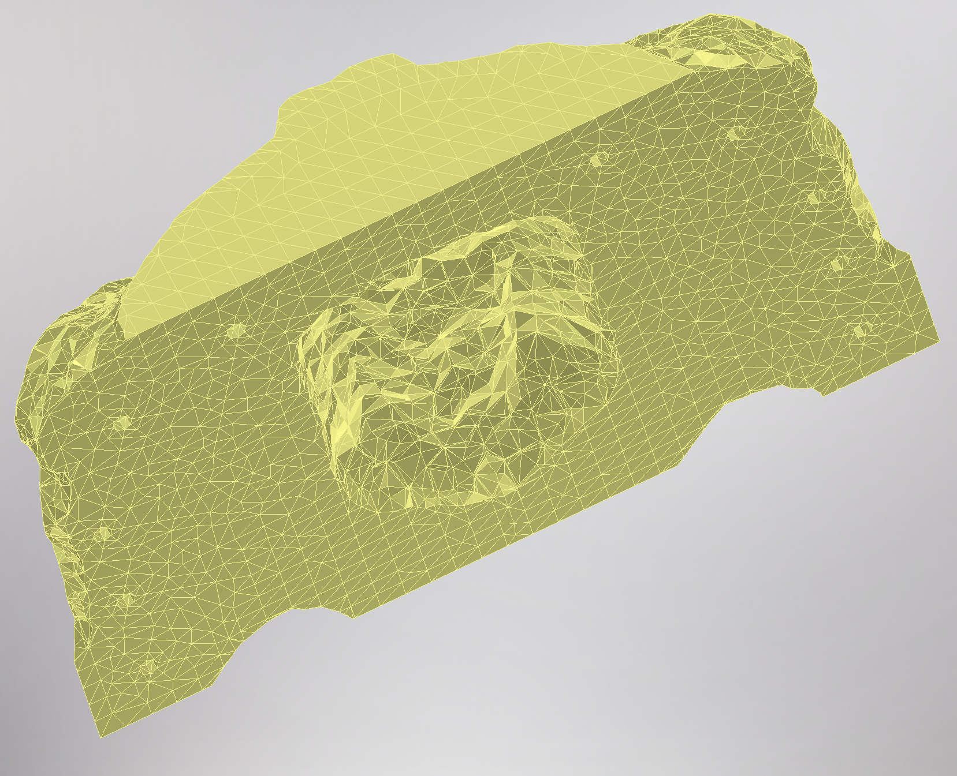
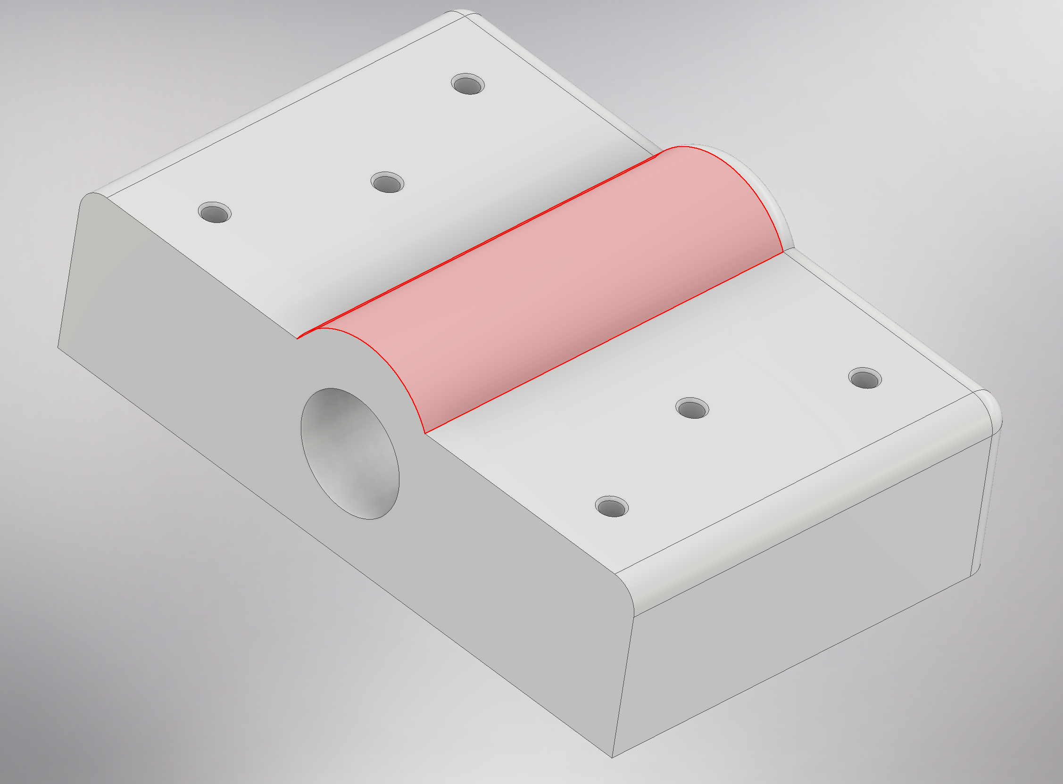
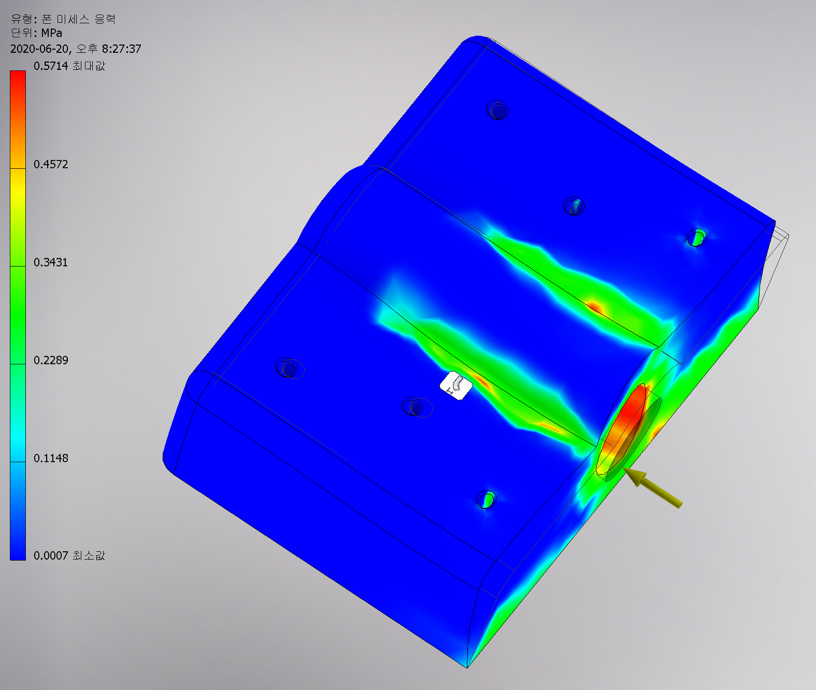
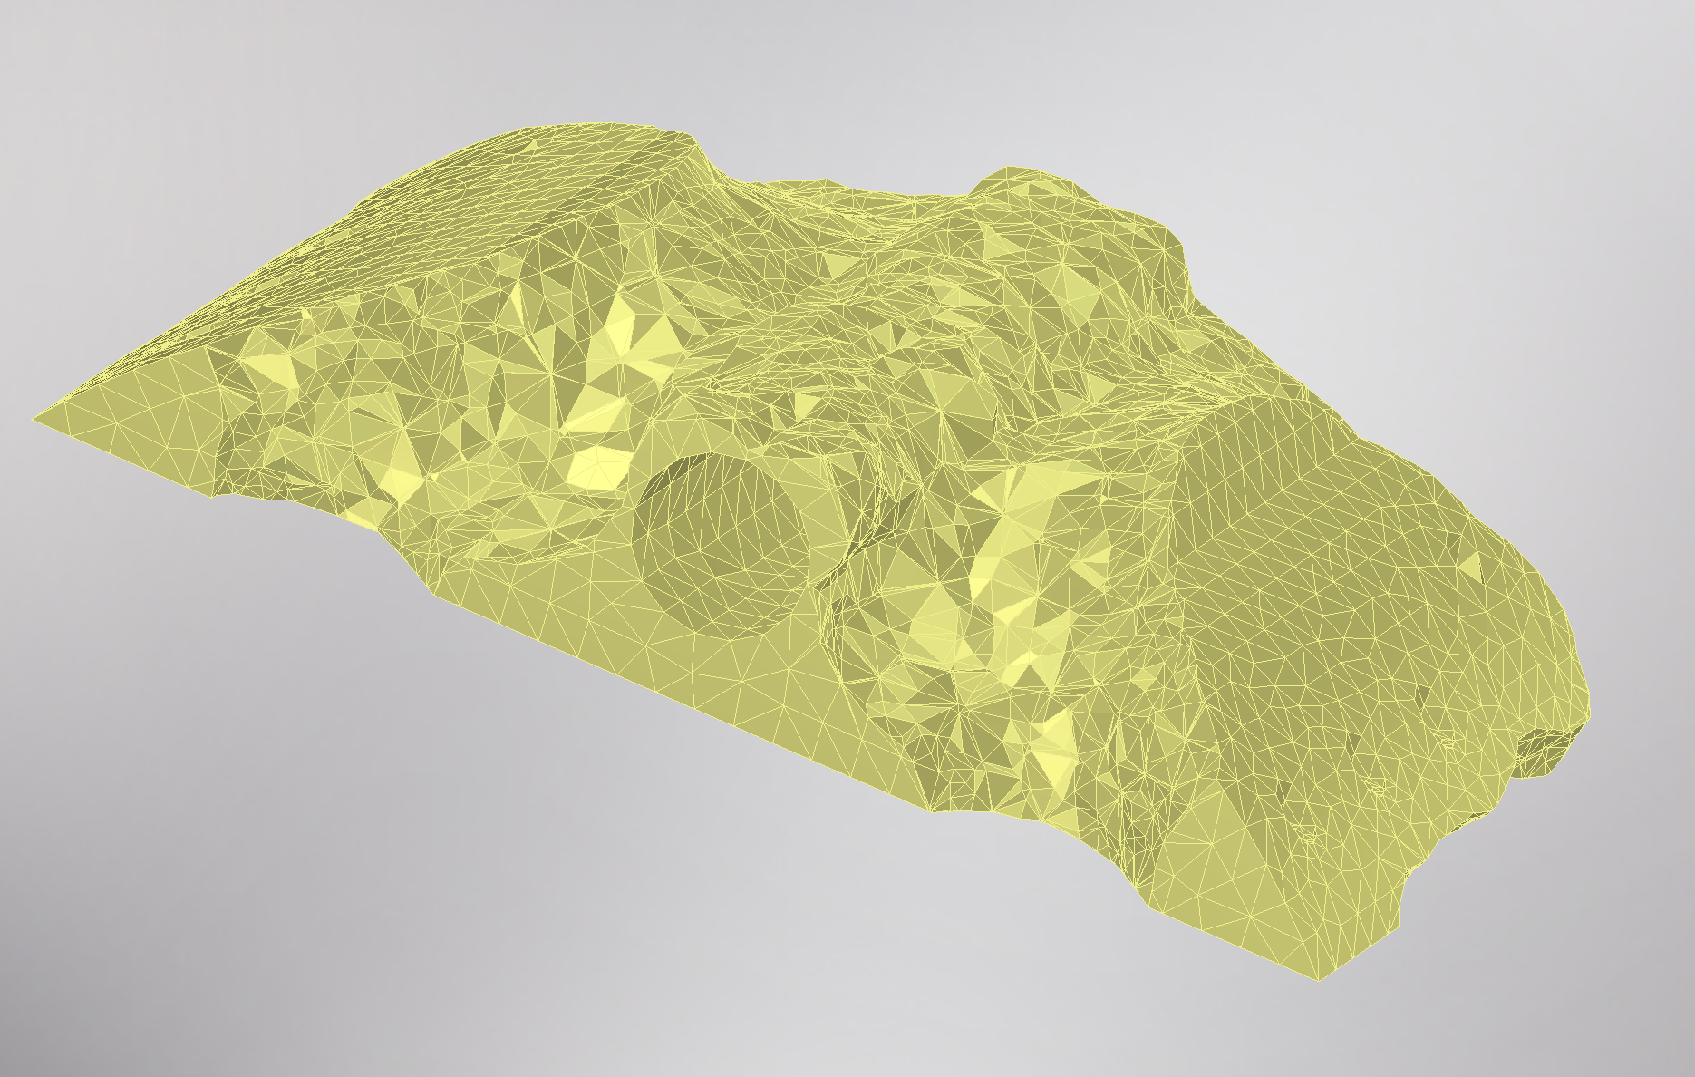
Engineering Process
The analysis was performed using FEM with Simple Hinge. In FEM, the heaviest and largest door in the current spec was analyzed. Its size and weight are 39 Kg, 1000mm x 2100mm. We used the FEM function of the Inventor and gave it the material properties of the Z-Ultrat ABS plastic hinge.
As a result of this, we identified the concentrated and unnecessary parts around the pin. Finally, topological optimization was performed using a shape generator of Inventor.
Topological Optimization
FEM

Slide 8
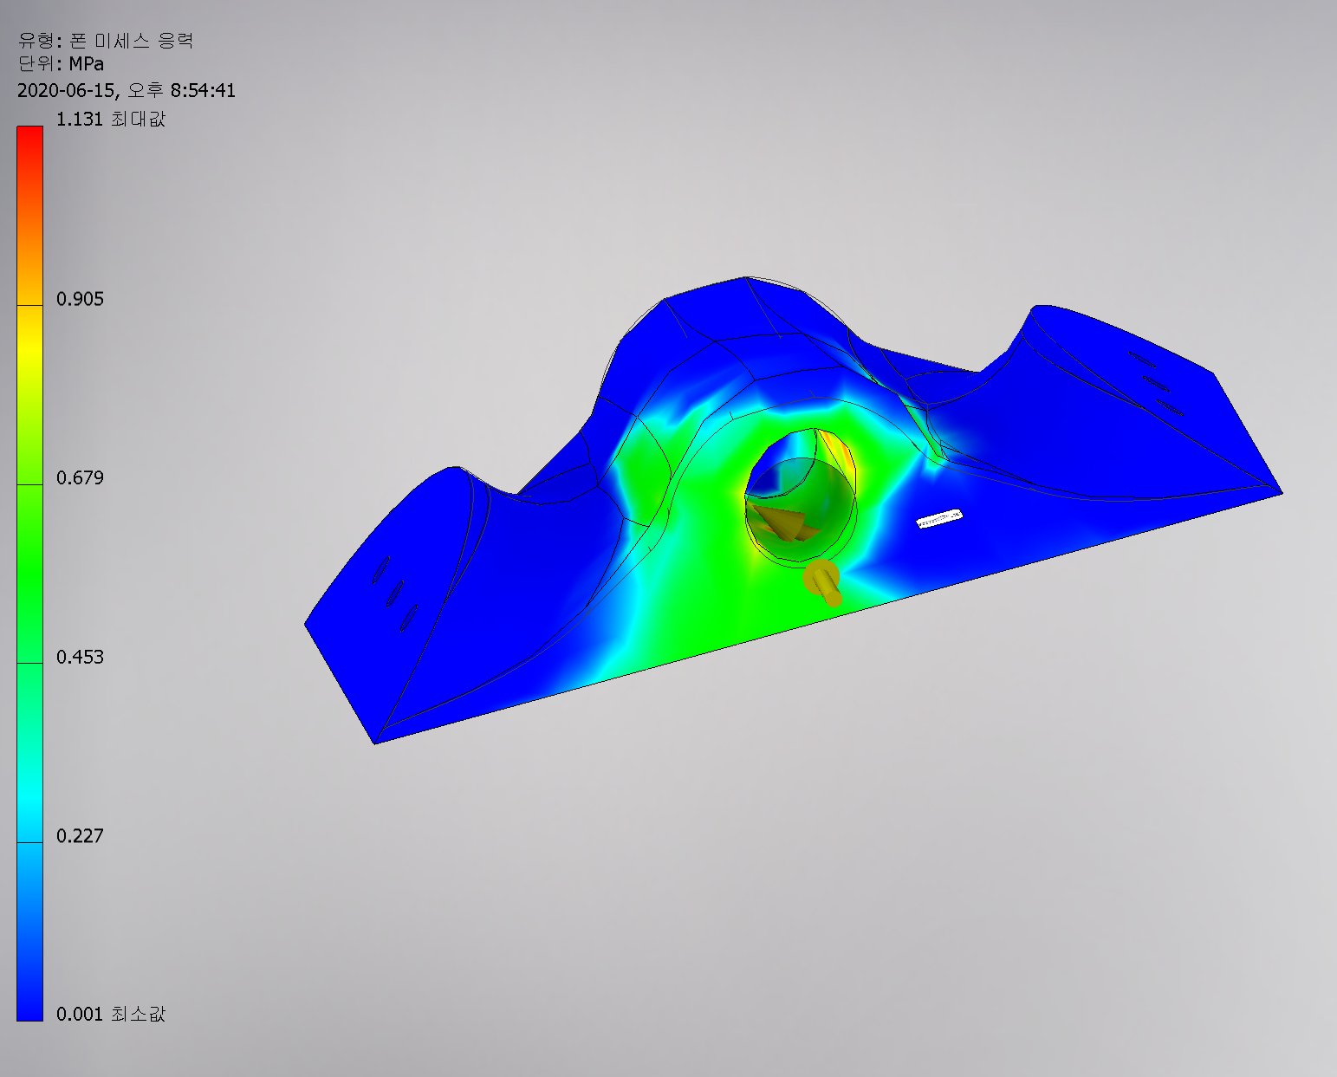
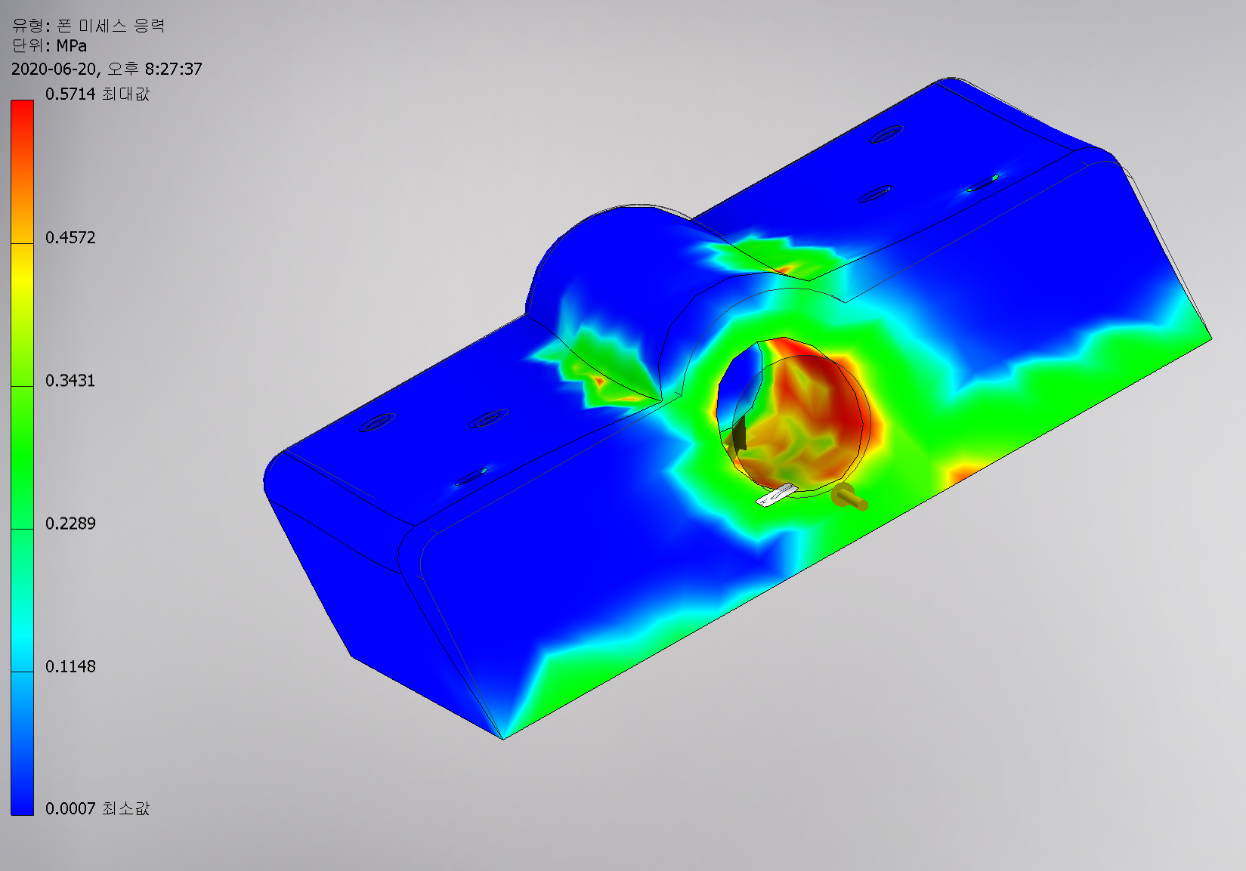
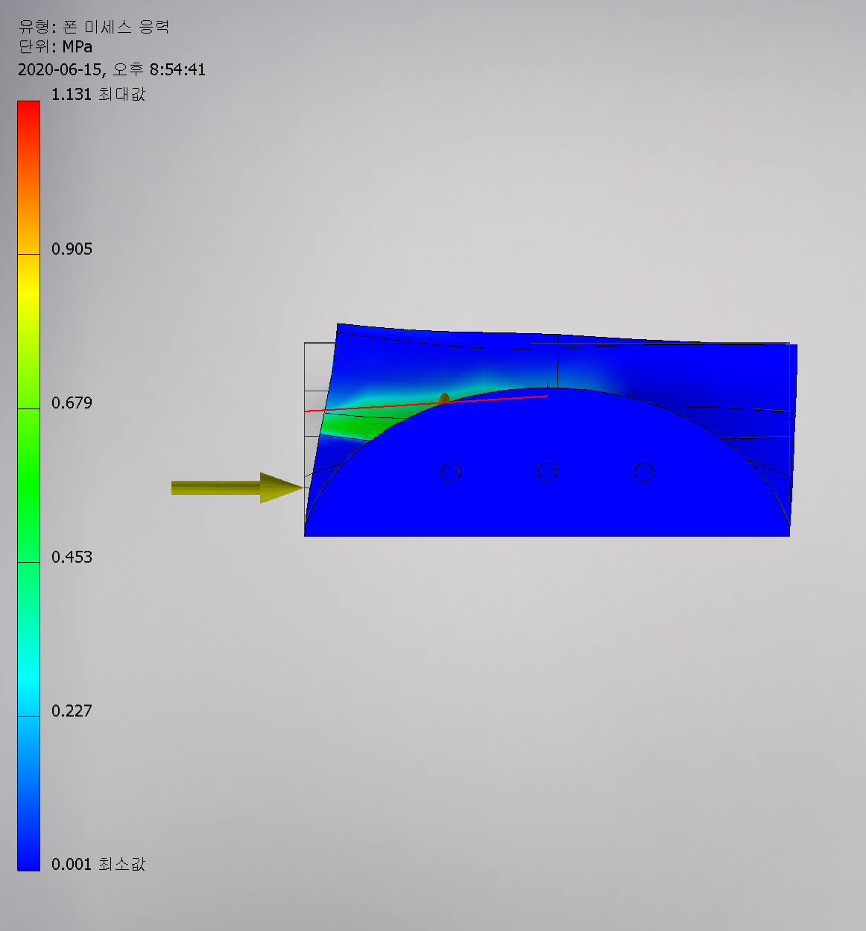
Redesign and Results Analysis
The hinge was redesigned based on the results of applying FEM and Topological Optimization. The results of analyzing our parts are shown on the left.
In the old design, the load was concentrated in the hole and 0.5714 Mpa was the maximum value. However, the redesigned part has no red zone appearing in the hole, and the maximum value is 1.131 MPa, improving performance.
Red zone appears
Max Tensile = 0.517 MPa
No Red Zone
Max Tensile = 1.131 MPa

Slide 9
DfAM Process and Advantage
Production Point
Since the DfAM method is a non-continuous lamination method, it may exhibit very low lamination strength. So, we have Parts in the same direction as the force when printing.
Advantage with DfAM
Due to the curved structure, it is difficult to produce using conventional methods. However, with 3D Printing, we can create a very economical hinge.
Because it is plastic and easy to install even if it affects durability, you can print and use it again at home.
2. The durability may be weaker than the existing hinge, but it can be used at a cycle similar to that of the other. Rather, it can be used longer because there is no deformation caused by foreign substances.
3. Parts except pins are the same parts. It is compatible, so replacement cost due to component damage is low.

